Slide 1
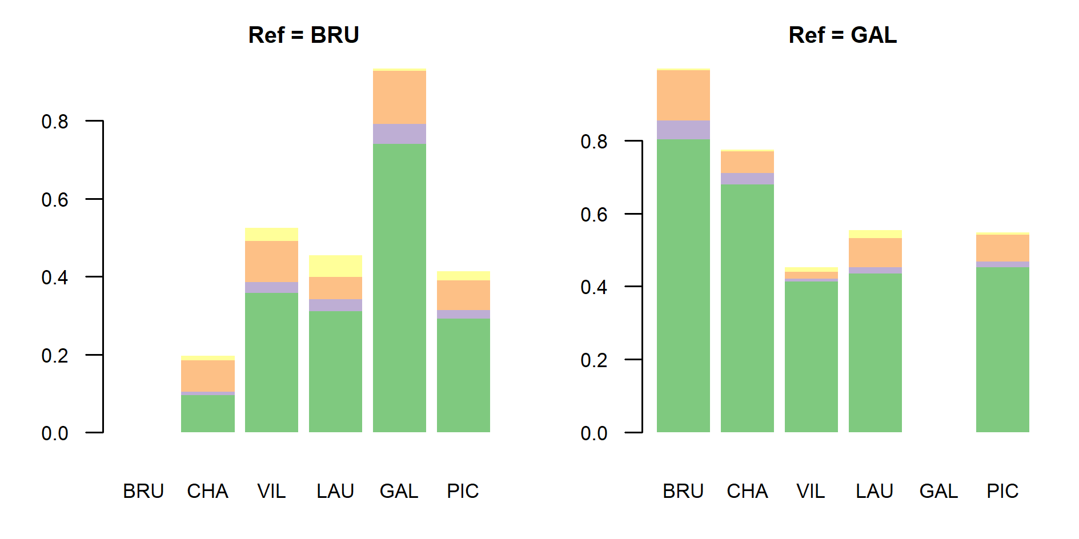
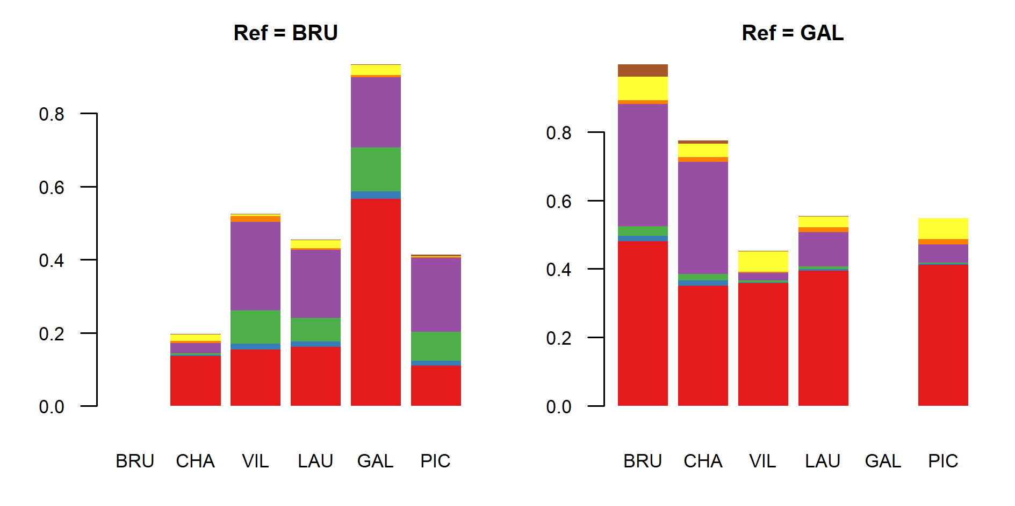
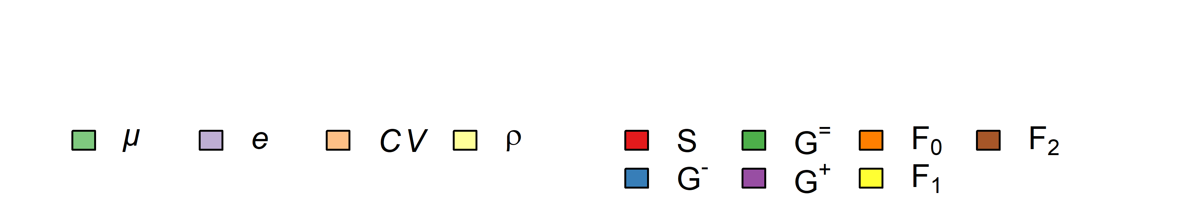
(a) (b)
(c) (d)

Slide 2
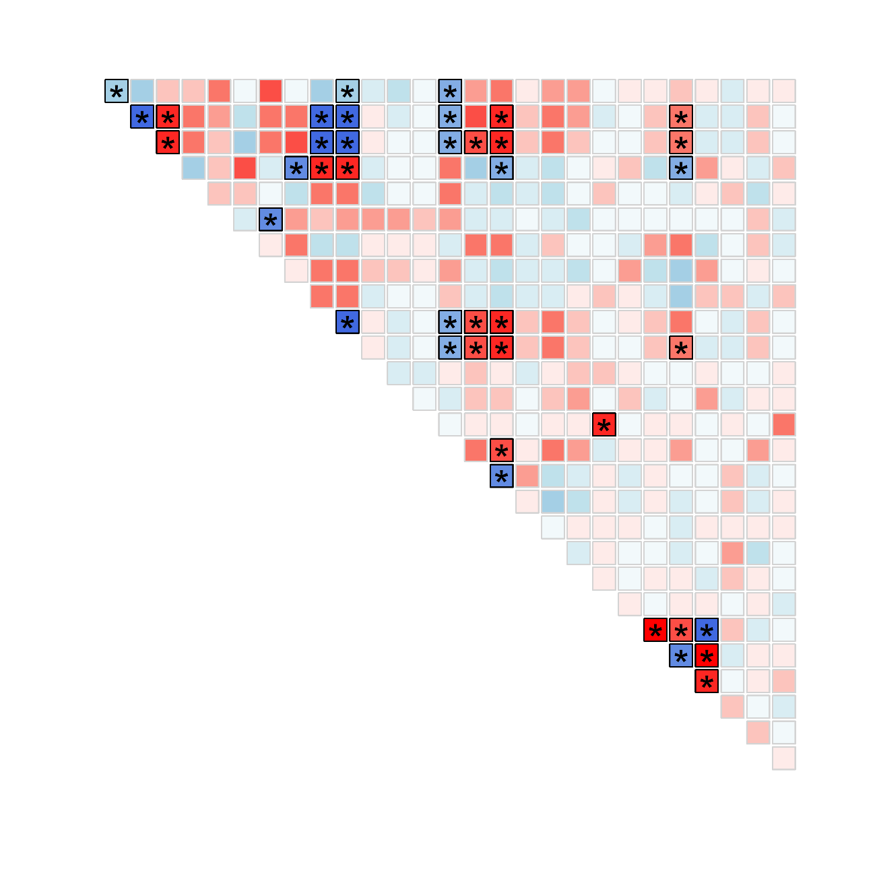
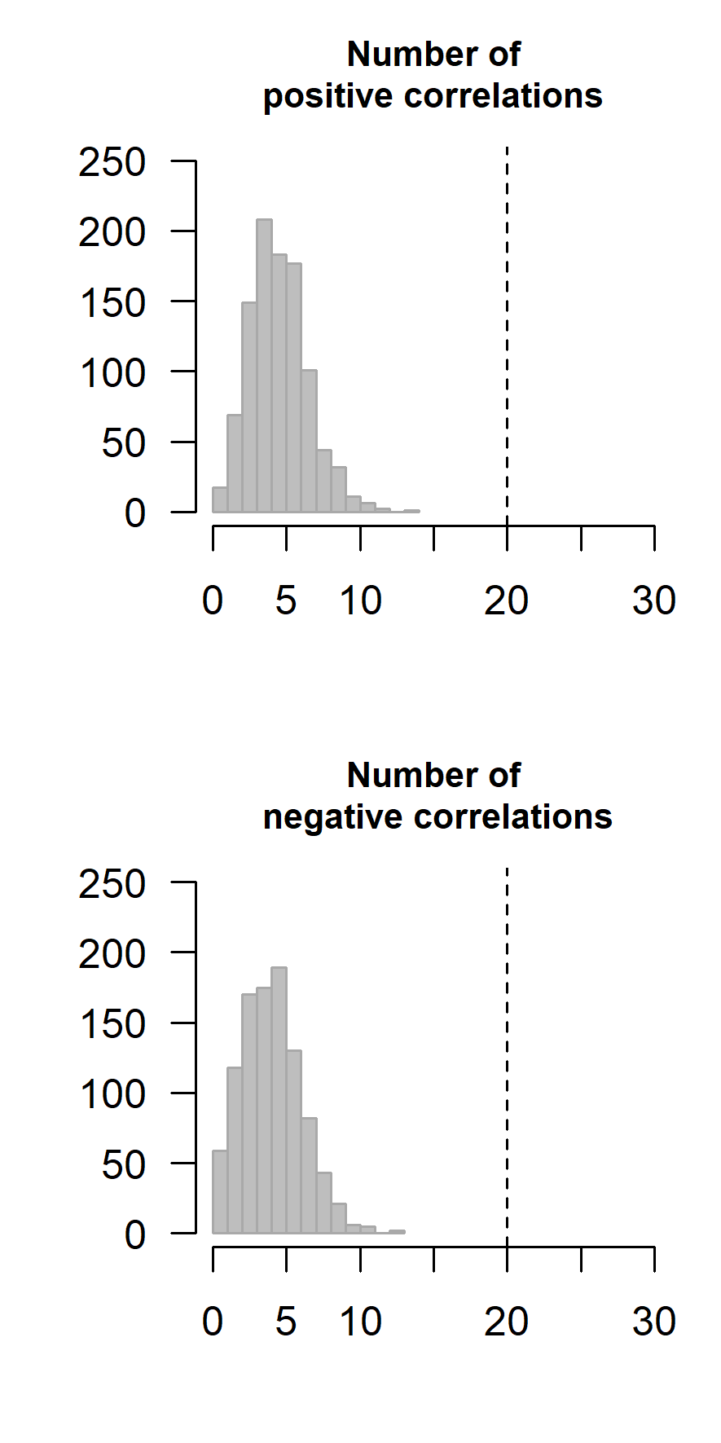
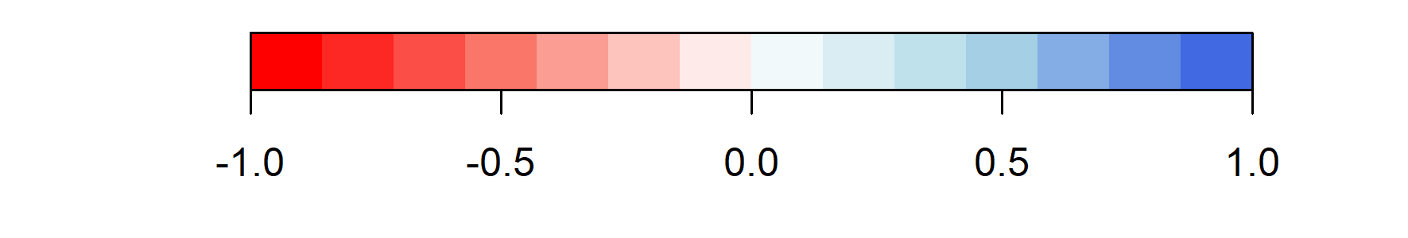
Ref = BRU
Means Elasticities Temporal variability Temporal correlations
G⁻ G⁼ G⁺ F₀ F₁ F₂ S G⁻ G⁼ G⁺ F₀ F₁ F₂ S G⁻ G⁼ G⁺ F₀ F₁ F₂ S G⁻ G⁼ G⁺ F₀ F₁ F₂
S
G⁻
G⁼
G⁺
F₀
F₁
F₂
S
G⁻
G⁼
G⁺
F₀
F₁
F₂
S
G⁻
G⁼
G⁺
F₀
F₁
F₂
Means Elasticities Temporal variability Temporal correlations
S
G⁻
G⁼
G⁺
F₀
F₁
Spearman’s correlation coefficient

Slide 3
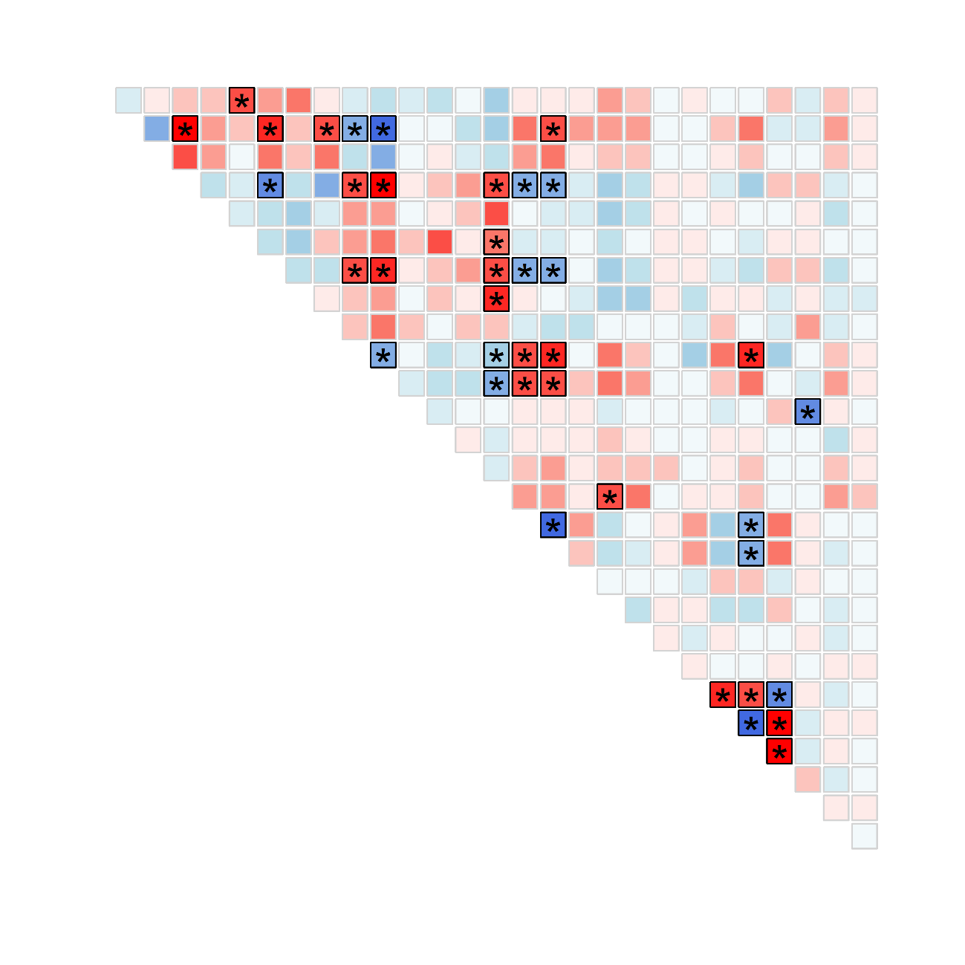
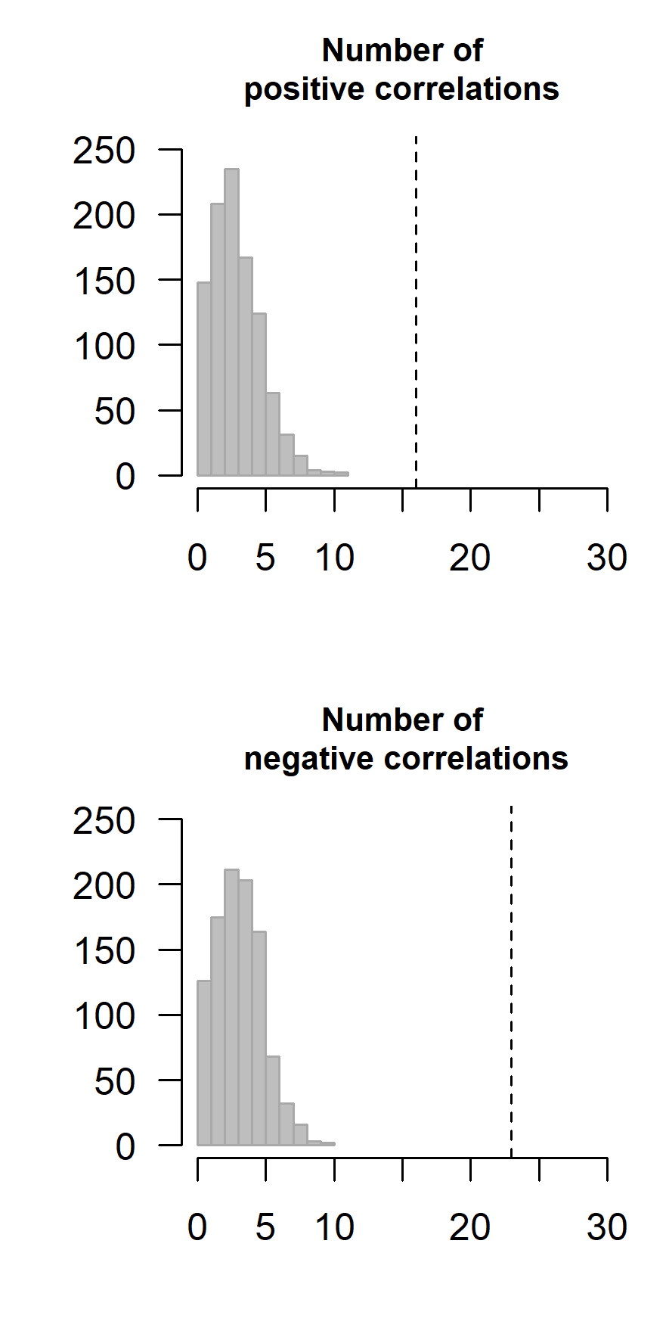
Ref = GAL
Means Elasticities Temporal variability Temporal correlations
G⁻ G⁼ G⁺ F₀ F₁ F₂ S G⁻ G⁼ G⁺ F₀ F₁ F₂ S G⁻ G⁼ G⁺ F₀ F₁ F₂ S G⁻ G⁼ G⁺ F₀ F₁ F₂
S
G⁻
G⁼
G⁺
F₀
F₁
F₂
S
G⁻
G⁼
G⁺
F₀
F₁
F₂
S
G⁻
G⁼
G⁺
F₀
F₁
F₂
Means Elasticities Temporal variability Temporal correlations
S
G⁻
G⁼
G⁺
F₀
F₁
Spearman’s correlation coefficient

Slide 4
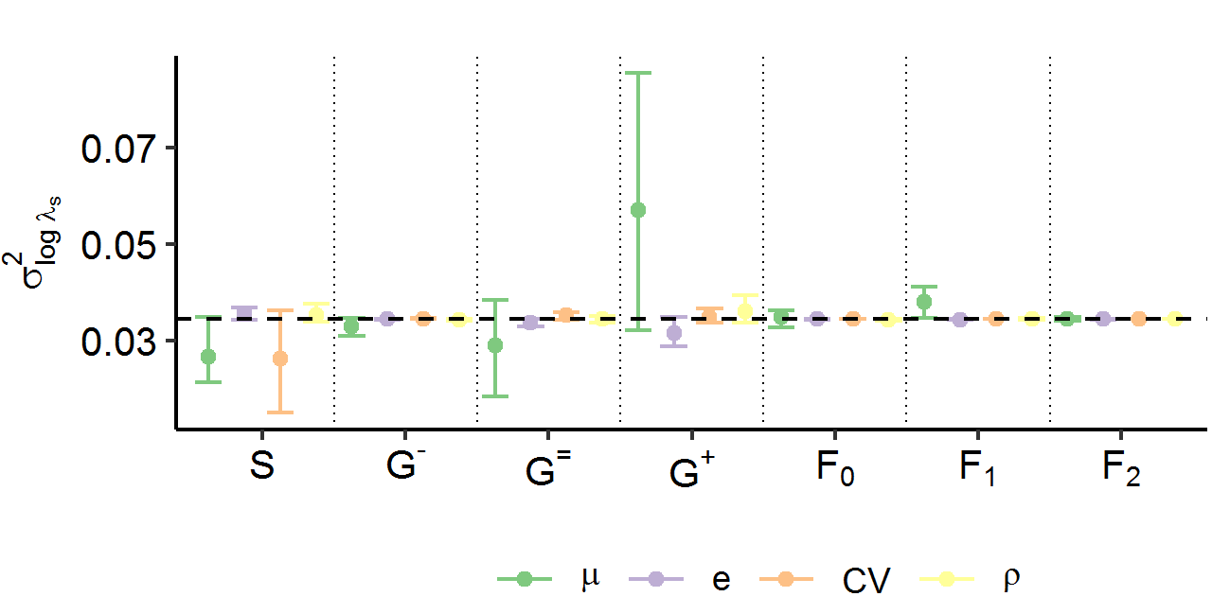
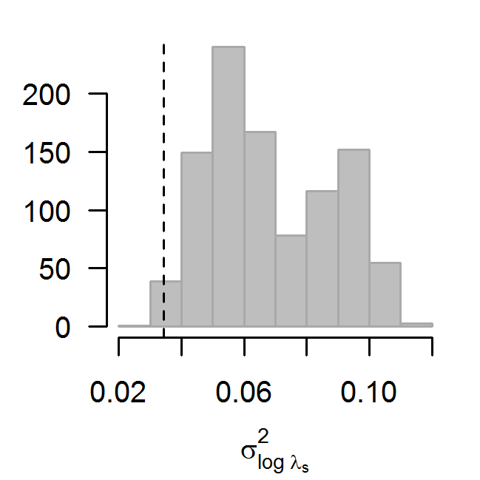
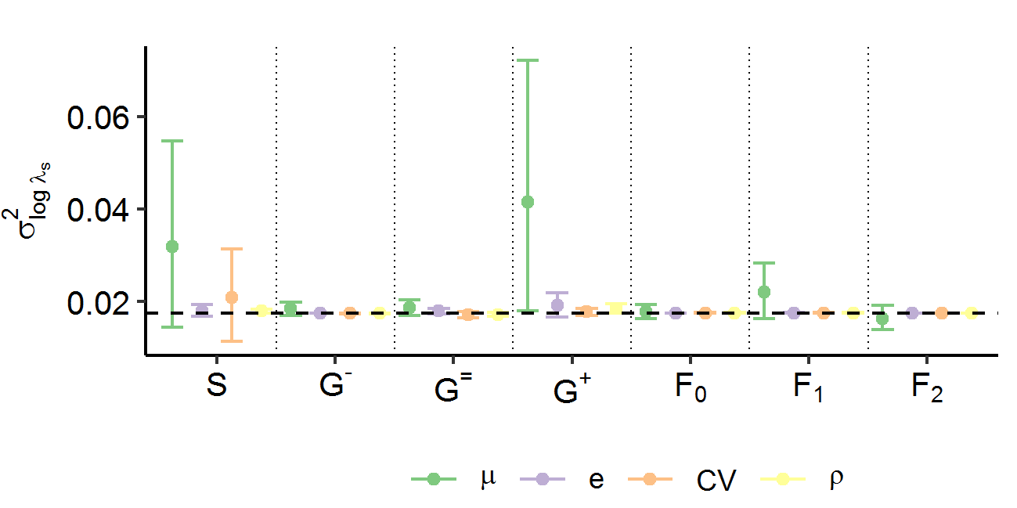
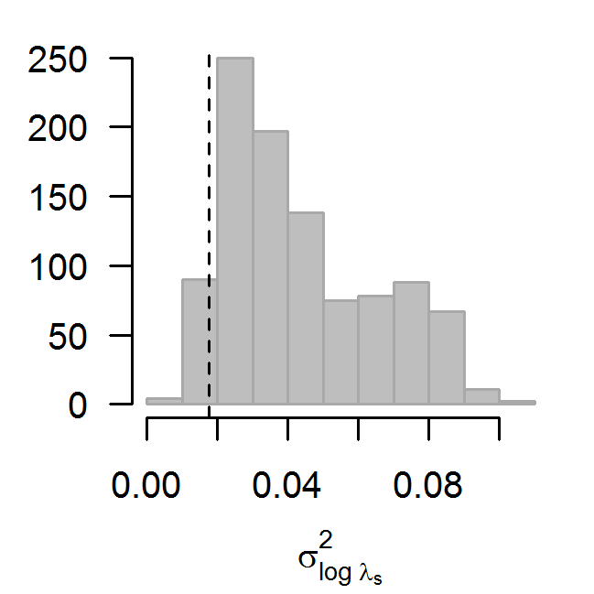
Ref = BRU
Ref = GAL

